Slide 1


Slide 2
Precision Teaching:
An Introduction
Altwood CofE Secondary
Scott I-Patrick
Tuesday 16th January 2017

Slide 3
Aim for Session
What is Precision Teaching?
PT: The underlying theory
How do you do PT?

Slide 4
What is Precision Teaching?
A way to plan, monitor and evaluate a teaching programme for an individual child, helping him/her to learn a specific skill.
It is a method of precisely measuring the effectiveness of teaching.
Precision Teaching is an ASSESSMENT tool and NOT a teaching method.

Slide 5
When can Precision Teaching be used?
When a child is making little or no progress in an area
When development of speed is essential for progress,
for example:
phonics
sight vocabulary
spelling high frequency words
number recognition
number bonds
For teaching skills that are measurable and need to be acquired to make progress

Slide 6
The Learning Hierarchy
Precision Teaching is based on the principle
that children (and adults) need to reach a certain level of fluency and accuracy when learning a new skill before they can maintain that skill without the need for further teaching.
The Learning Hierarchy* identifies five important stages in skill development.
*Haring N.G. & Eaton M.D. (1978) Systematic Instructional Procedures: An Instructional Hierarchy

Slide 7
‘Hierarchy of Learning’
(Haring and Eaton, 1978)
Acquisition
Fluency
Maintenance
Generalisation
Adaptation
Pupil performs skill with accuracy.
Pupil performs skill with accuracy and fluency.
Proficiency level reached, demonstrating maintenance in terms of accuracy and fluency.
With support and instruction pupil can apply skill in new and different contexts.
Without specific instruction pupils applies skill in new and different contexts.
Notes:
Gemma
Ok so here’s the right order with some definitions…
Once each step has been achieved, can progress to the next step
PRESS MOUSE FOR RED CIRCLE
The social skill sessions that you will be delivering over 6 weeks focus on the first two stages – the acquisition and fluency of their new skills.
The other 3 stages are dependant on practice both within the sessions but more importantly from opportunities to practice and receive feedback from outside the sessions, e.g. classroom, playground and home.

Slide 8
Acquisition – you are learning to drive and need to think carefully when changing gears, indicating etc - Just beginning to learn the skill, some degree of accuracy but performance not yet reliable – by the end of this phase performance is basically accurate but not fluid, automated
Fluency – you can change gears without thinking and can now focus on the road - Can perform the skill quickly and accurately – this phase brings speed of performance into the equation – skill becoming automated, ‘second nature’
Maintenance – 6 months after, when you came back from a long holiday, you can still drive - Due to regular reinforcements, can perform the skill over a lengthy period of time – fluent performance is sustained over time – often referred to as ‘mastery’ stage
Generalisation – Your friend ask you to drive their car and you are able to do so with some support and instruction - Can generalise the skill to different contexts/new situations, can transfer learning across settings
Adaptation – Driving a different car is not a problem anymore - Can adapt the skill appropriately to learn new skills NB. Overlap between generalisation & adaptation stages

Slide 9
The Doing

Slide 10
Before you start Precision Teaching
Consistency is key!
When?
Where?

Slide 11
How do you do Precision Teaching?
Identify a specific difficulty and acquire a baseline.
Set a target.
Teaching sessions: short, frequent and target specific.
Monitor child’s daily performance using a probe.
Chart results and make note of teaching methods.
Analyse the data to determine if a change of target is needed or change in teaching method.

Slide 12
STEP 1
Identify a specific difficulty and acquire a baseline

Slide 13
‘Task Analysis’ – where are they now?
Select a problem area, e.g. sight words, letter sounds
Find out what the child already knows, probably by doing a short test

Slide 14
Probes
Probes contain a defined set of items, often letters, words or sums on which the child is tested, usually for one minute.
The items chosen reflect the skills the child is having difficulty acquiring, but contain some that the child knows.

Slide 15
Types of probe:
See to say e.g. letter, number, sight word recognition
Hear to write e.g. letter sounds, numbers, spellings
See to write e.g. 3 + 6 =

Slide 16
Initial Assessment
Use the ‘100 high-frequency words in order’, Copies of these are in your pack.
Start at the beginning of the probe sheets and work your way through the pack. It is worthwhile giving easier probes even if you think the pupil is already competent in those skills as this confirms earlier skills and provides the pupil for a ‘warm-up’ opportunity.

Slide 17
Initial Assessment
Tell the child you are going to show him/her a grid of words which you want them to read out loud to you, once you say “start”.
Use a 1 minute sandtimer or stopclock counting down from 60 seconds to tell you when the 1 minute probe is up
Keep a note of right/wrong responses as the child reads, but do not correct or help the child

Slide 18
Initial Assessment
When the sandtimer finishes/stopclock beeps, stop the child, thank them, and share how they did.
On your chart, note the probe given, put in the number of correct/incorrect responses the child gives, and make a note of specific problem words.
Stop when the pupil shows more errors than correct responses or earlier if failure is becoming obvious.

Slide 19
Initial Assessment
Remember to record your results for each probe sheet administered on the summary sheet in your pack.

Slide 20
Step 2 - Setting a Target
SMART TARGETS
S
Specific
Measurable
Agreed
Realistic
Time bound
M
A
R
T

Slide 21
2. Targets
Target needs to contain three essential components:
Observable verb
(ie. what the child will do)
Conditions
(e.g. teaching materials or teacher instructions)
Criterion
(success criteria – how will we know it’s been successful?)

Slide 22
2. Targets
E.g.
“Scott will read aloud (observable verb) 50 words per minute with no more than 2 errors (conditions) on three consecutive days (criterion).”

Slide 23
Step 3- Teaching (Up to 10 mins per day)
Choose up to three words the child struggled with from your baseline assessment (NB: the number of words chosen to focus on may vary according to child’s difficulties).
Introduce the target words to child.
Use teaching strategies which will increase opportunities for child to recognise the words.

Slide 24
3. Teaching methods
E.g. Direct Instruction
Model (adult) – “this word says…”
Lead (together) – “say it with me”
Test (child) – “you say it”… or “what word?”
Use the model-lead-test sequence with each sight word in turn
Alter the sequence and continue until each word has been repeated 3-5 times
Explain to the pupil that they are going to try the sight words alone- but they may have help if they want it
The pupil tries the words alone – praise correct answers. If the word is incorrect or if the pupil hesitates more than 2 seconds use the correction procedure:
Model (adult) “this word says…”
Test (child) “now you say it”… or “what word?”

Slide 25
Points to remember
Make sure the pace is good- keep things flowing
Include pointing, to signal the pupil’s turn
Include intonation
Praise must be immediate, specific, positive
Avoid word-building- just give the sight word

Slide 26
Step 4 – Monitoring Performance
Using a Probe sheet

Slide 27
PT Probe Generator
http://johnandgwyn.co.uk/probe.html

Slide 28
Step 5- Chart Results
Chart results with the child – helps to motivate the child & increase confidence.
Helps teacher to see which teaching methods are most effective for particular pupil (record on chart).
Record any changes made to task.
Record the number of correct AND incorrect words.
If you are unable to do the probe on a particular day, that line is left blank.

Slide 29
5. Ratio charts
The days the information is collected
This is shown on the horizontal axis.
There is a line for each school day.
The result is filled in on the line (NOT the space).
If you are unable to do the probe on a particular day, that line is left blank.
That day is known as a No Chance Day.
A description of the pupil’s performance
This is shown on the vertical axis.
It tells you the accuracy at which the pupil does the task.
This is expressed as a rate measurement i.e. the number of responses per minute.

Slide 30
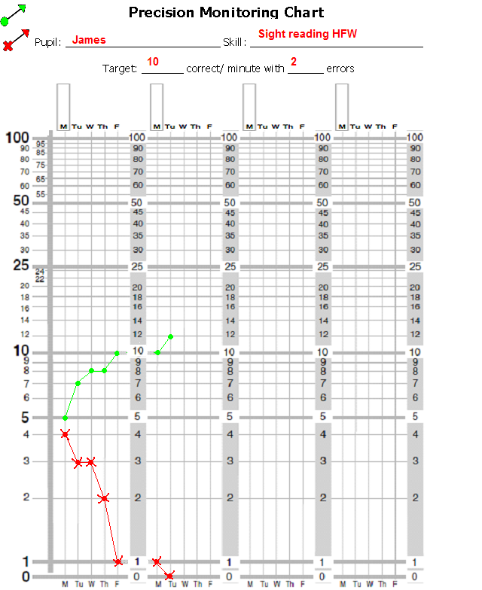

5. Recording
Pupil_______________
Criterion:
_____ correct with
max ____errors
Key:
Correct answers
Incorrect answers
Remember: Do not join across
weekends or across days when a
pupil was not tested.

Slide 31
Setting Aim Rates
Suggested minimum Fluency Markers:
Infant Pupils = 40 correct per minute
Junior Pupils = 50 cpm
Secondary = 60 cpm
Suggested minimum
Accuracy Markers:
See-to-say = 3 or less
MAINTENANCE- ACHIEVE THE TARGET FOR 3
CONSECUTIVE DAYS
See-to-say

Slide 32
Step 6- Analyse the Data
Once the child has hit their target for 3 consecutive days move on to a new set of words.
The 3 day rule
Check after 3 days:
If the task appears too hard consider reducing the demands of the task (e.g. number of words to be learnt, types of words being learnt).
The 8 day rule
Check after 8 days:
If the pupil is not at or near their target after 8 days consider a change (e.g. increasing motivation, modifying teaching method, changing task).

Slide 33
6a. Change - response to data analysis
Chart Description
Chart Picture
Interpretation
Intervention
More errors than correct: No sign of a switch
x
Task inappropriate
3 day rule applies
Return or slice the task
Switch within first 3 days
x
Task probably inappropriate. Monitor progress, may be a blip
May need to return or slice the task
Both correct and incorrect rates increasing
x
Pupil is merely getting faster attempting more on the probe
Slow pupil down; encourage accuracy before speed
Some progress; accurate but shallow correct rate slope
x
Task is likely to be appropriate but progress not fast enough
Increasing motivation through rewards/ incentives or alter teaching methods

Slide 34
6b. Maintenance
Once a pupil has reached fluency (hit target 3 days consecutively), change target
Check for maintenance at regular intervals by using an old probe to check they are still fluent with these words or interleave previously learnt words with new words

Slide 35
Recap of the steps of precision monitoring
Identify a specific difficulty and acquire a baseline
Set a target
Teaching sessions (DI): short, frequent and target specific
Monitor pupil’s daily performance using a probe
Chart results (PM) and make note of teaching methods
Analyse the data to determine if a change of target is needed or change in teaching method

Slide 36
Thank You
Please do not use or copy any slides without prior permission from AFC EPS

Slide 37
End slide

